Slide 1
COMP 4500
Week 9 - Monday

Slide 2
Last time
What did we talk about last time?
Weighted interval scheduling

Slide 3
Questions?

Slide 4
Assignment 5

Slide 5
Logical warmup
There are five pirates who wish to divide 100 gold coins
These pirates are ranked:
  Captain
  Lieutenant
  Master
  Midshipman
  Seaman
In order of rank, each pirate gets the opportunity to propose a plan for dividing up the gold
If at least half of the pirates (including the proposer) agree on the proposition, it is carried out
Otherwise, the pirate is killed and the next highest ranking pirate makes a proposal
Pirates are completely rational, who value, in this order:
  Staying alive
  Maximizing gold coins received
  Seeing other pirates die
If you were the captain, what would you propose?
Hint: Work backwards!

Slide 6
Back to Weighted Interval Scheduling

Slide 7
Weighted interval scheduling
The weighted interval scheduling problem extends interval scheduling by attaching a weight (usually a real number) to each request
Now the goal is not to maximize the number of requests served but the total weight
Our greedy approach is worthless, since some high value requests might be tossed out
We could try all possible subsets of requests, but there are exponential of those
Dynamic programming will allow us to save parts of optimal answers and combine them efficiently

Slide 8
p(j) examples
Index
1
2
3
4
5
6
2
p(1) = 0
p(2) = 0
p(3) = 1
p(4) = 0
p(5) = 3
p(6) = 3
4
4
7
2
1

Slide 9
More algorithm design
Consider an optimal solution O
  It either contains the last request n or it doesn't
If O contains n, it does not contain any requests between p(n) and n
Furthermore, if O contains n, it has an optimal solution for the problem for just requests 1, 2, …, p(n)
  Since those requests don't overlap with n, they have to be the best or they wouldn't be optimal
If O does not contain n, then O is simply the optimal solution of requests 1, 2,…, n - 1

Slide 10
Subproblems found!
It might not be obvious, but the last slide laid out a way to break a problem into smaller subproblems
Let OPT(j) be the value of the optimal solution to the subproblem of requests 1, 2,…, j
OPT(j) = max(v_{j} + OPT(p(j)), OPT(j – 1))
Another way to look at this is that we will include j in our optimal solution for requests 1, 2,…,j
iff v_{j} + OPT(p(j)) ≥ OPT(j – 1)

Slide 11
We've already got an algorithm!
Compute-Opt(j)
  If j = 0 then
    Return 0
  Else
    Return max(v_{j} + Compute-Opt(p(j)), Compute-Opt(j – 1))

Slide 12
How long does Compute-Opt take?
6
Well, for every request j, we have to do two recursive calls
Look at the tree from the requests a few slides back
5
3
4
3
2
1
3
2
1
1
2
1
1
Uh oh.
1

Slide 13
Needless recomputation
The issue here is that we are needlessly recomputing optimal values for smaller subproblems
You might recall that we had a similar problem in COMP 2100 with the naïve implementation of a recursive Fibonacci function
In the worst case, the algorithm has an exponential running time
Just how exponential depends on the structure of the problem

Slide 14
Memoization
The solution is something called memoization, which means storing the value for an optimal solution whenever you compute it
Then, if you need it again, you just look it up (from the memo you left yourself)
To make this work, we need an array M of length n that stores the optimal value found for each request
  Initially, it's all -1 or null or another value that indicates empty

Slide 15
Updated algorithm
M-Compute-Opt(j)
  If j = 0 then
    Return 0
  Else if M[j] is not empty then
    Return M[j]
  Else
    M[j] = max(v_{j} + M-Compute-Opt(p(j)), M-Compute-Opt(j – 1))
    Return M[j]

Slide 16
Running time of memoized algorithm
Constant non-recursive work is done inside of each call
The recursion will be constant if M[j] already has a value
There will only be n cases when M[j] doesn't have a value
The running time is O(n)
Note that sorting the requests in the first place takes O(n log n)

Slide 17
Going beyond the value
We have only found the value of an optimal solution, not the actual intervals included
As with many dynamic programming solutions, the value is the hard part
For each optimal value, we could keep the solution at that point, but it would be linear in length
Storing that solution would require O(n²) space and make the algorithm O(n²) in order to keep it updated

Slide 18
Reconstructing the solution
Recall that j is in our optimal solution if and only if v_{j} + OPT(p(j)) ≥ OPT(j – 1)
On that basis, we can backtrack through the M array and output request j only if the inequality holds

Slide 19
Algorithm for solution
Find-Solution(j, M)
  If j = 0 then
    Output nothing
  Else if v_{j} + M[p(j)] ≥ M[j – 1] then
    Output j together with the result of Find-Solution(p(j))
  Else
    Output the result of Find-Solution(j – 1)
Algorithm is O(n)

Slide 20
Three-sentence Summary of Principles of Dynamic Programming and Segmented Least Squares
Student Lecture

Slide 21
Principles of Dynamic Programming

Slide 22
Why is this dynamic programming?
The key element that separates dynamic programming from divide-and-conquer is that you have to keep the answers to subproblems around
It's not simply a one-and-done situation
Based on which intervals overlap with which other intervals, it's hard to predict when you'll need an earlier M[j] value
Thus, dynamic programming can often give us polynomial algorithms but with linear (and sometimes even larger) space requirements

Slide 23
Iterative vs. recursive
The array M is thus the key to this (and other similar) dynamic programming algorithms
The same problem could have been tackled with a non-recursive approach where you compute each M[j] in order
Every dynamic programming problem can use either:
  Memoized recursion
  Building up solutions iteratively
The two solutions are equivalent, but the book will prefer iterative solutions, since they are usually faster in practice and easier to analyze

Slide 24
Iterative solution to weighted interval scheduling
Iterative-Compute-Opt
  M[0] = 0
  For j = 1 up to n
    M[j] = max(v_{j} + M[p(j)], M[j – 1])
Algorithm is (even more obviously) O(n)

Slide 25
Informal guidelines
Weighted interval scheduling follows a set of informal guidelines that are essentially universal in dynamic programming solutions:
  There are only a polynomial number of subproblems
  The solution to the original problem can easily be computed from (or is one of) the solutions to the subproblems
  There is a natural ordering of subproblems from "smallest" to "largest"
  There is an easy-to-compute recurrence that lets us compute the solution to a subproblem from the solutions of smaller subproblems

Slide 26
Segmented Least Squares

Slide 27
A line of best fit
Given some data, it is easy to construct a line of best fit

Slide 28
What does such a line look like?
Consider a set P of n points {(x₁, y₁), (x₂, y₂), …, (x_{n}, y_{n})}
We want to define a line L as y = ax + b
Such that its error is minimized
$$Error\left(L,P\right)=\sum_{i=1}^{n}{{\left(y_{i}−ax_{i}−b\right)}^{2}}$$

Slide 29
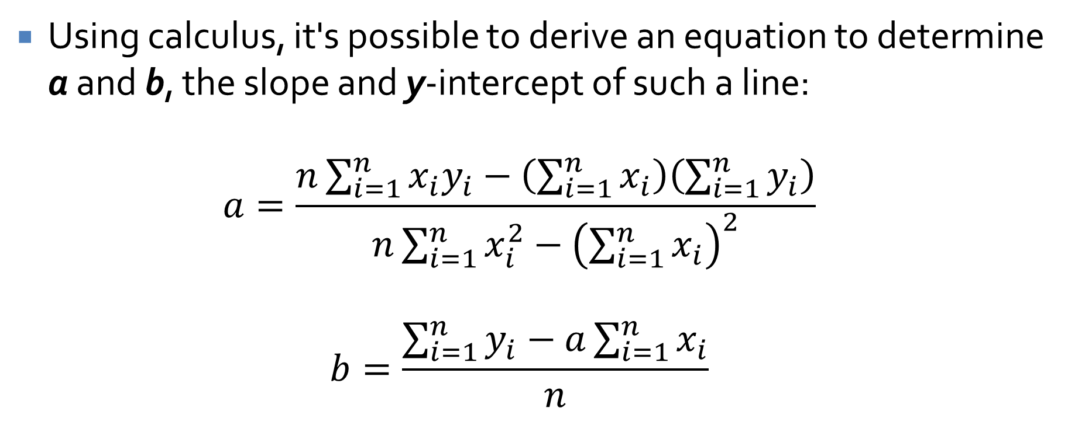
Finding such a line
Using calculus, it's possible to derive an equation to determine a and b, the slope and y-intercept of such a line:
$$a=\frac{n\sum_{i=1}^{n}{x_{i}y_{i}}−\left(\sum_{i=1}^{n}{x_{i}}\right)\left(\sum_{i=1}^{n}{y_{i}}\right)}{n\sum_{i=1}^{n}{x_{i}^{2}}−{\left(\sum_{i=1}^{n}{x_{i}}\right)}^{2}}$$
$$b=\frac{\sum_{i=1}^{n}{y_{i}}−a\sum_{i=1}^{n}{x_{i}}}{n}$$

Slide 30
But what if the data really falls on two lines?
A single line would have terrible error
But how do we know that there are two lines?

Slide 31
Or three lines?

Slide 32
We can't allow any number of lines
If we only care about error, n – 1 lines will always be the best
  We could just put a line between each adjacent pair of points and have no error
But that's obviously stupid
Somehow, we need an algorithm that gives us the intuitively correct number of lines
We need a penalty for adding more lines

Slide 33
Formulating the problem
We get a set P of n points {(x₁, y₁), (x₂, y₂), …, (x_{n}, y_{n})}
For simplicity, x₁ < x₂ < … < x_{n}
Let p_{i} be (x_{i}, y_{i})
We want to partition P into segments
Each segment is a contiguous set of x-coordinates:
  {p_{i}, p_{i+1}, …, p_{j-1}, p_{j}} for indexes i ≤ j

Slide 34
Minimizing the penalty
Using the formula from earlier, we compute lines minimizing the error for each segment
The penalty of the whole partition is the sum of:
  The number of segments multiplied by some constant C > 0
  The error value of the optimal lines through each segment
C is a constant provided to the algorithm
  The higher the C, the greater then penalty for having more segments

Slide 35
Algorithm design
How many ways are there to partition a list of n items?
  2^{n-1}
  We can't consider all possible partitions
Somehow, we need to divide the problem into smaller subproblems
The last point p_{n} is in the last segment, whatever it is
That segment starts at some point p_{i}
If we knew the last segment, we could recursively solve the problem on points p₁, p₂,…,p_{i-1}

Slide 36
More algorithm design
Let OPT(i) be the optimum solution for points p₁, p₂,…,p_{i}
Let e_{i,j} be the minimum error of any line with respect to p_{i},p_{i+1},…,p_{j}
It must be the case that, if the last segment of the optimal partition is p_{i},p_{i+1},…p_{n}, then the value of the optimal solution is:
  OPT(n) = e_{i,n} + C + OPT(i – 1)

Slide 37
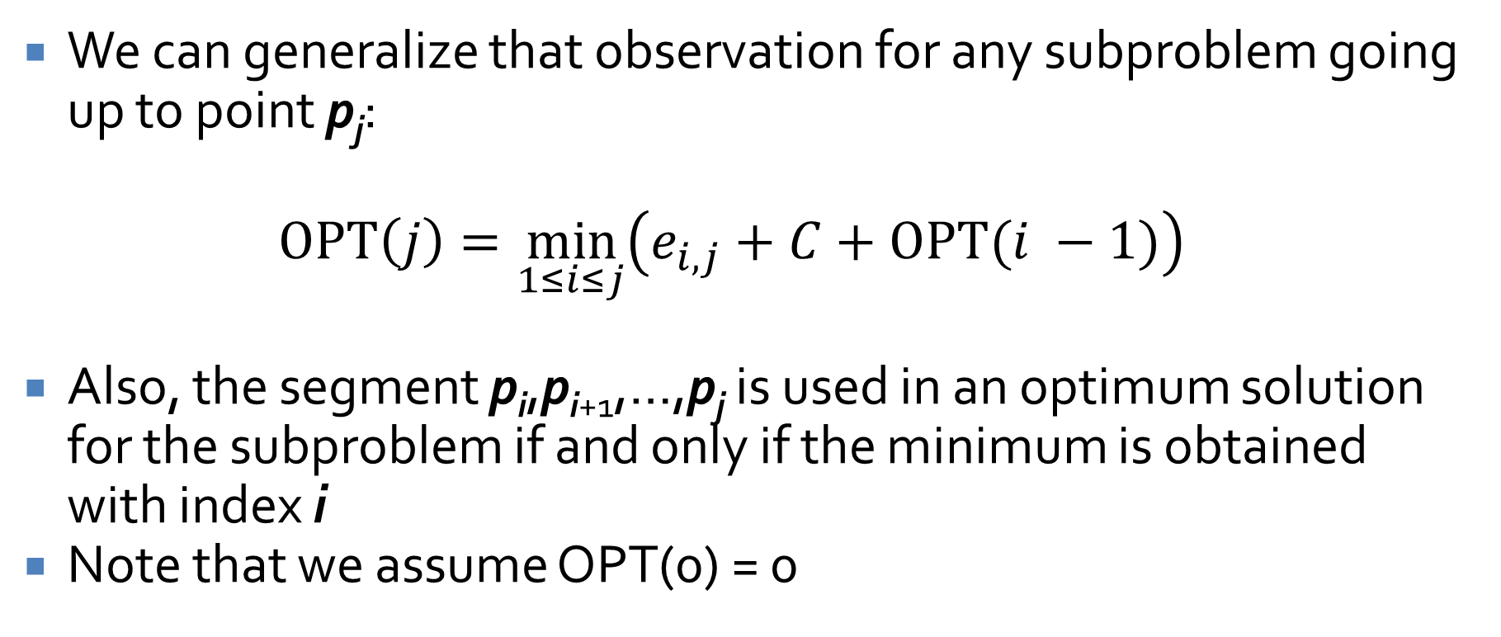
Final recurrence
We can generalize that observation for any subproblem going up to point p_{j}:
$$OPT\left(j\right)=\min_{1≤i≤j}\left(e_{i,j}+C+OPT(i −1)\right)$$
Also, the segment p_{i},p_{i+1},…,p_{j} is used in an optimum solution for the subproblem if and only if the minimum is obtained with index i
Note that we assume OPT(0) = 0

Slide 38
Algorithm
Segmented-Least-Squares(n)
  Create array M with indexes 0 through n
  Set M[0] = 0
  For all pairs i ≤ j
    Compute the least squares error e_{i,j} for segment p_{i},p_{i+1},...p_{j}
  For j = 1 up to n
    For i = 1 up to j
      Set M[j] = min(M[j], e_{i,j} + C + M[i-1])
  Return M[n]

Slide 39
Reconstructing the segments
As before, we only find the total penalty value with the previous algorithm, not the actual segments themselves
We use the observation that the segment p_{i},p_{i+1},…,p_{j} is used in an optimum solution for a subproblem if and only if the minimum was obtained using index i
Note that this minimal i could be recorded during the initial algorithm

Slide 40
Algorithm for segments
Find-Segments(j)
  If j = 0 then
    Output nothing
  Else
    Find an i that minimizes e_{i,j} + C + M[i-1]
    Output the result of Find-Segments(i – 1) and the segment {p_{i},p_{i+1},…,pj}

Slide 41
Running time
First, we have to compute the values of the least-squares errors e_{i,j}
  There are O(n²) pairs (i,j)
  It takes O(n) time to compute each least-squares error for each pair
  The total is O(n³), but there are tricks that can get it down to O(n²)
The algorithm has nested For loops, for j from 1 up to n and for i from 1 up to j, a total of O(n²)
Let k be the number of segments
  Reconstructing the segments takes O(kn) time, unless the minimal i values are recorded, in which case it takes O(k + n) time, which is O(n)
Thus, the total is O(n³) unless using tricks to get the error computation down to O(n²)

Slide 42
Quiz

Slide 43
Upcoming

Slide 44
Next time…
Subset sums and knapsacks

Slide 45
Reminders
Read section 6.4
Start Assignment 5

